Slide 1
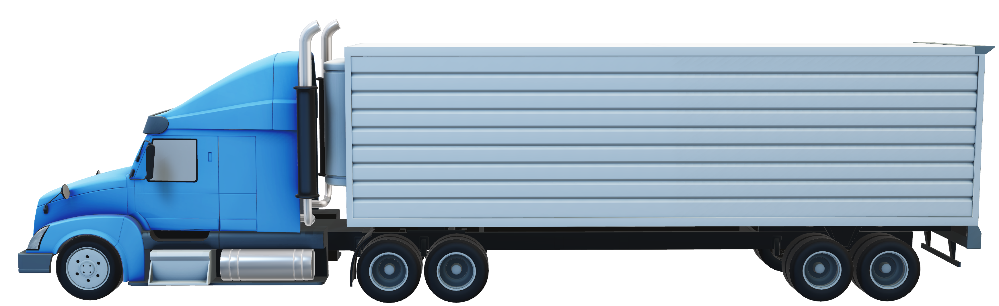
Az National Trucking
Risk Analysis

Slide 2
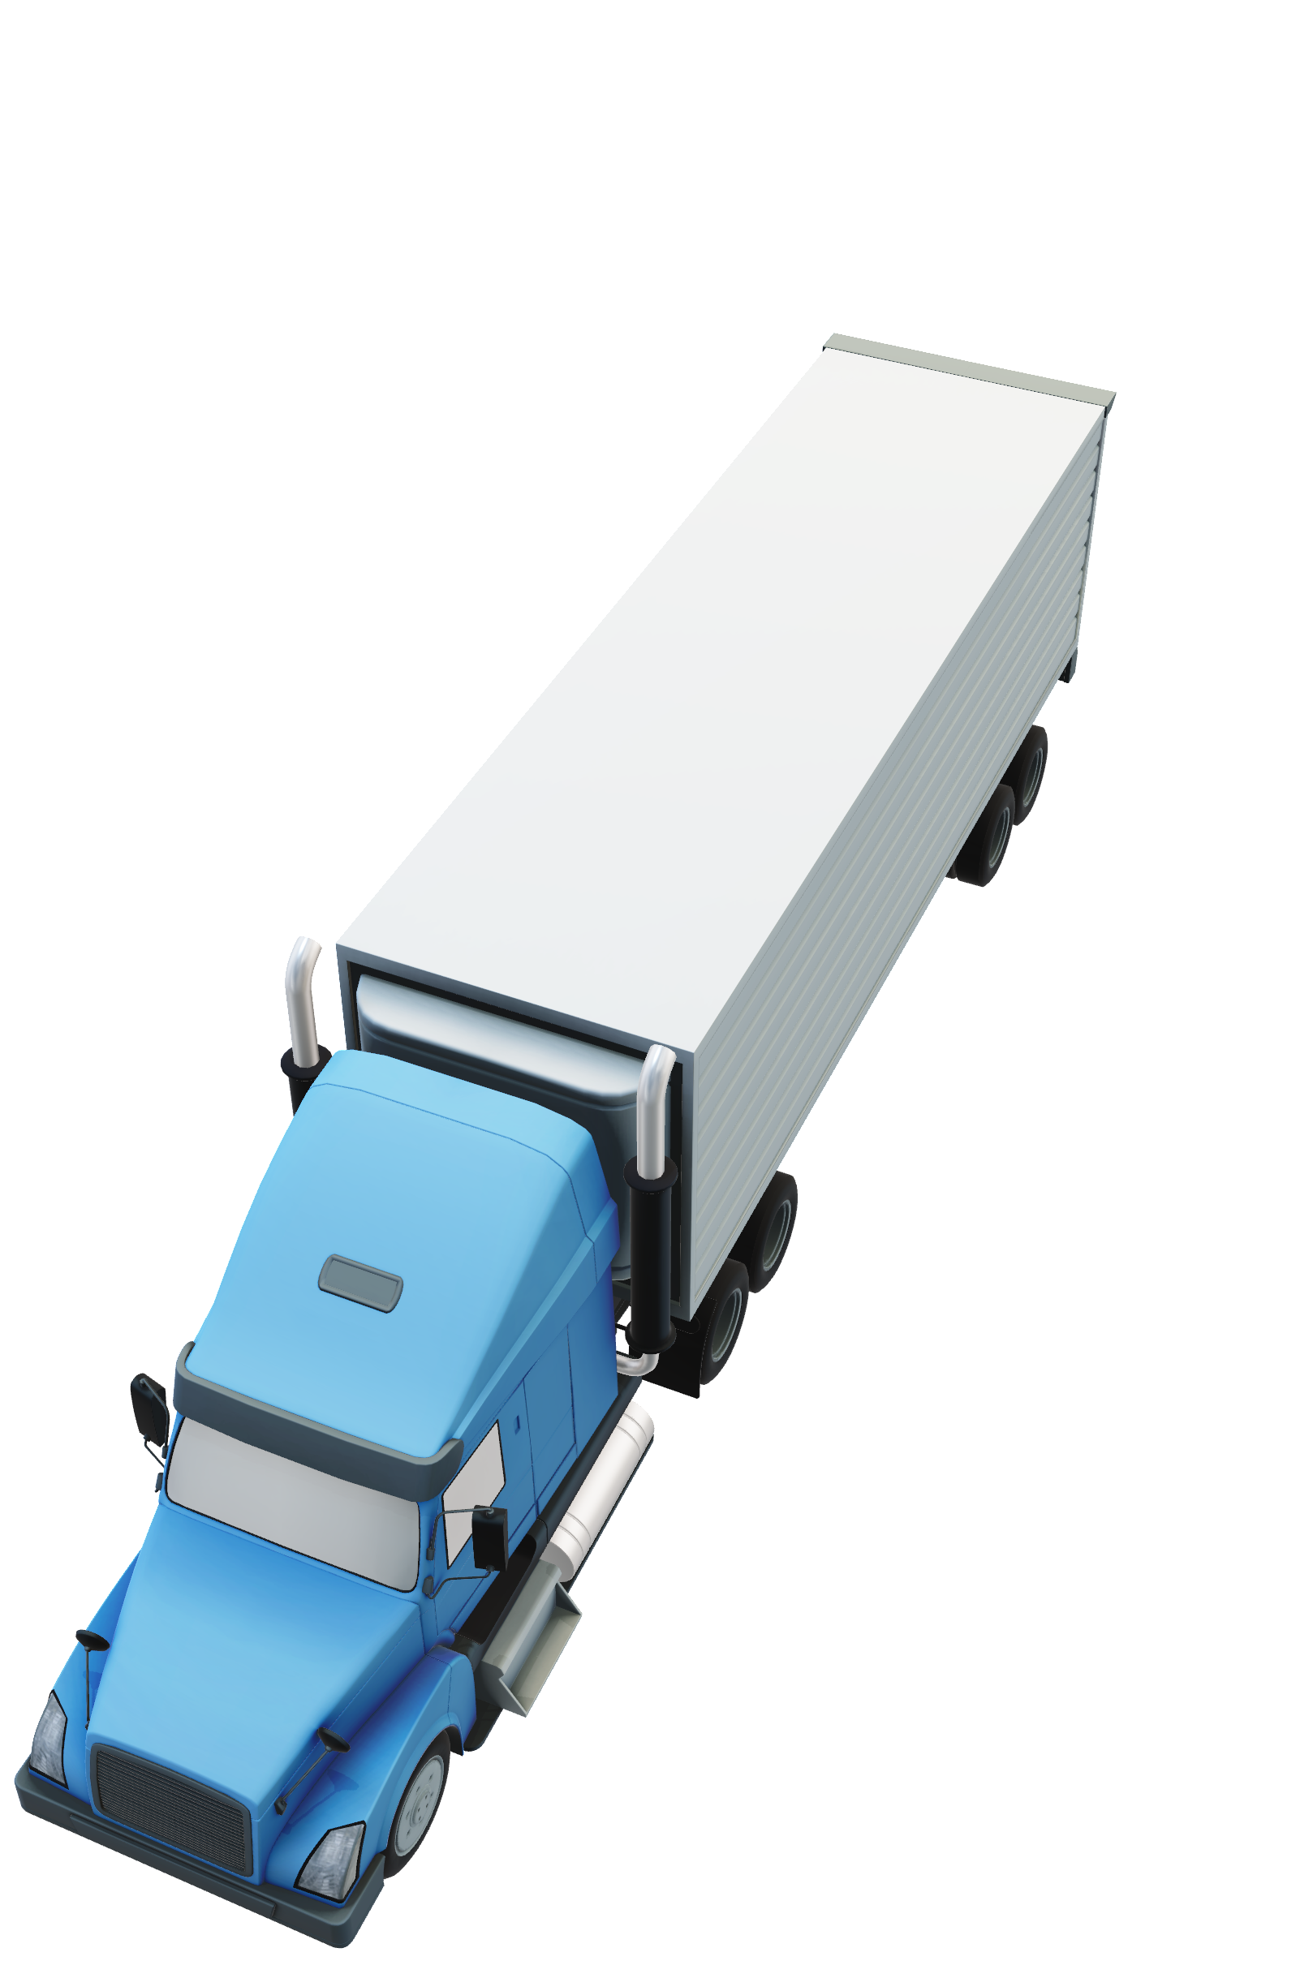
agenda
Problem Statement
Data Workflow
Analysis
Challenges
Conclusion

Slide 3
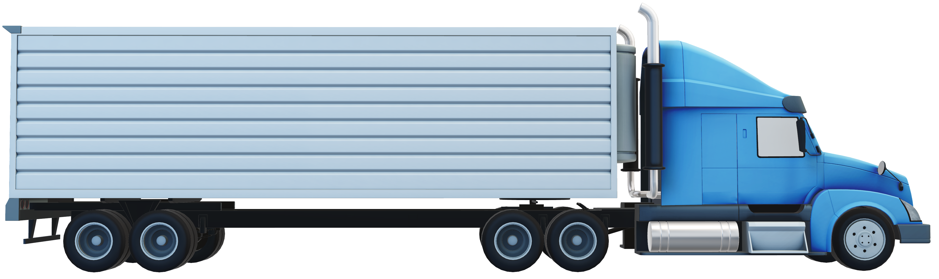
PROBLEM STATEMENT
3
High number of injuries and fatalities resulting from heavy truck accidents in California.
High insurance rates due to the accidents.
OBJECTIVES
Identify unsafe drivers by calculating risk factors using risk assessment metrics.
Analyzing the factors affecting risk for truck drivers using various parameters such as risk factor, location model.
Notes:
ANT has been in existence for ten years. It employs 400 people in total, specializing in broad and non-specialized cargo kinds, and its main line of business is long distance trucking services .
The high number of injuries and fatalities that occur from large truck accidents in California makes it imperative for fleet managers to make sure that every driver in the fleet abides by the company's policies and does not represent an insurance risk for any number of reasons.
The aim is to lower the number of significant commercial collisions in California, and eventually, the injuries and fatalities that result from them by examining each driver's data and implementing safety measures to minimize the risks involved and reduce the insurance risk.
Ultimately, assess and forecast the risk factors related to drivers by considering several elements such as events, total distance travelled, average speed, and mileage.

Slide 4






DATA Workflow
Download the CSV files to the local system
Move the files to VMware
Move files from local to HDFS
Import tables to Tableau for Visualisation
Import data to Impala
Populate the tables using PIG

Slide 5
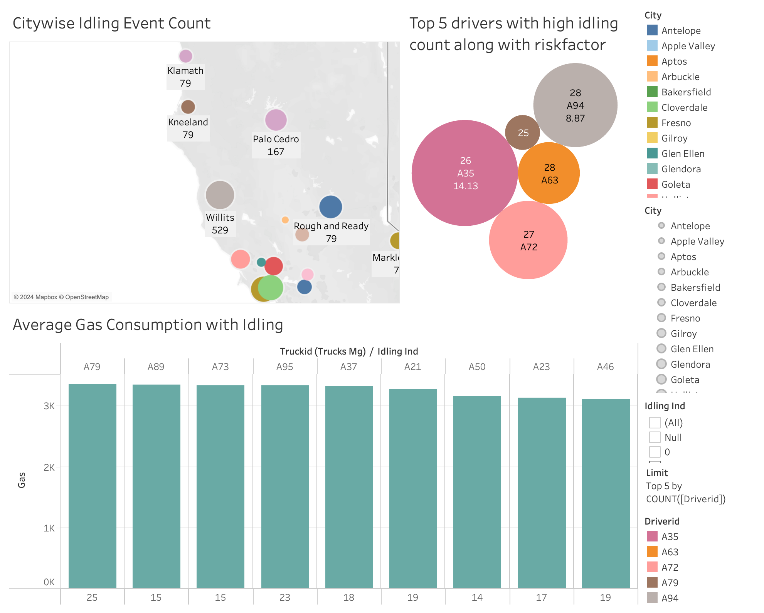
Analyzing Idling Events and Fuel Efficiency Across Cities
Idling Challenges in Willits:
Investigate high idling events (529) in Willits to optimize routes and reduce fuel inefficiencies.
Risk and Efficiency Training:
Target training on efficient driving and safety for drivers with high risk factors to decrease idling and improve fuel usage.

Slide 6
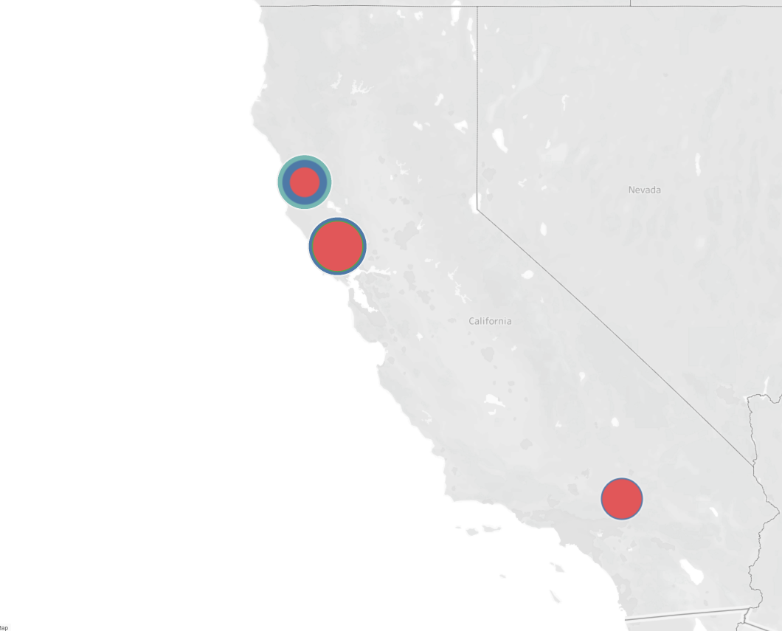
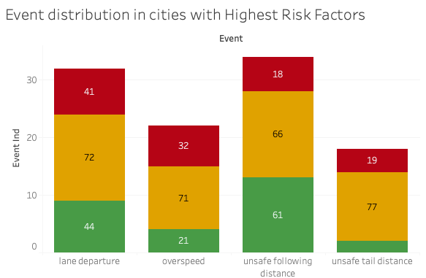
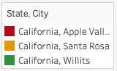
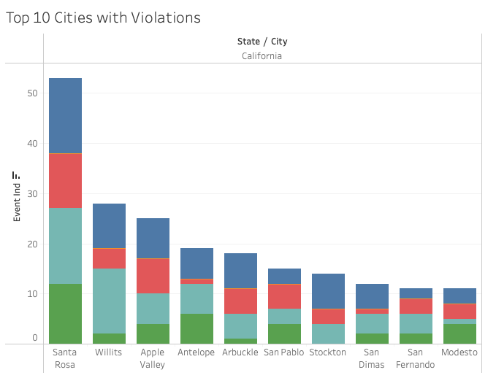
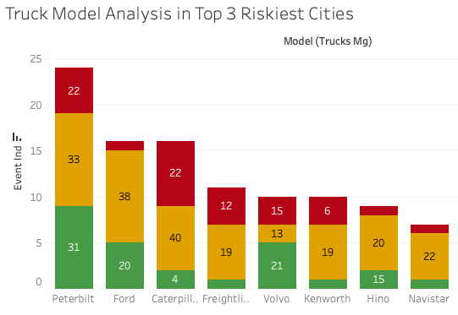
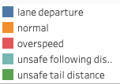
Analyzing Top 3 risky cities
Santa Rosa exhibit a concentrated risk profile, followed by Willits and Apple Valley signaling a need for targeted safety measures.
Unsafe following distance, lane departure, unsafe tail distance, and overspeed are prevalent high-risk events in these areas.
Ford, Caterpillar, Peterbilt, and Volvo trucks are notably associated with elevated risks, implying potential concerns regarding design, training, or maintenance.

Slide 7
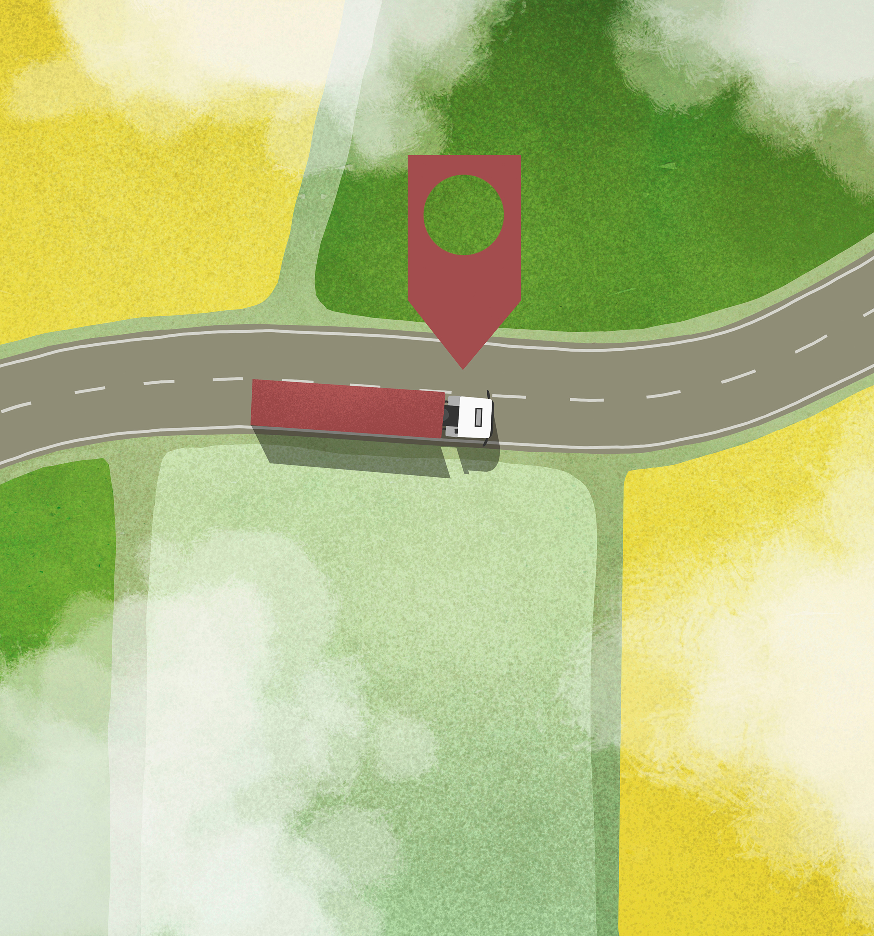

Challenges
San Fernando longitude was incorrect.
Corrected it by -110 degrees
Connecting Tableau with Hive Server

Slide 8

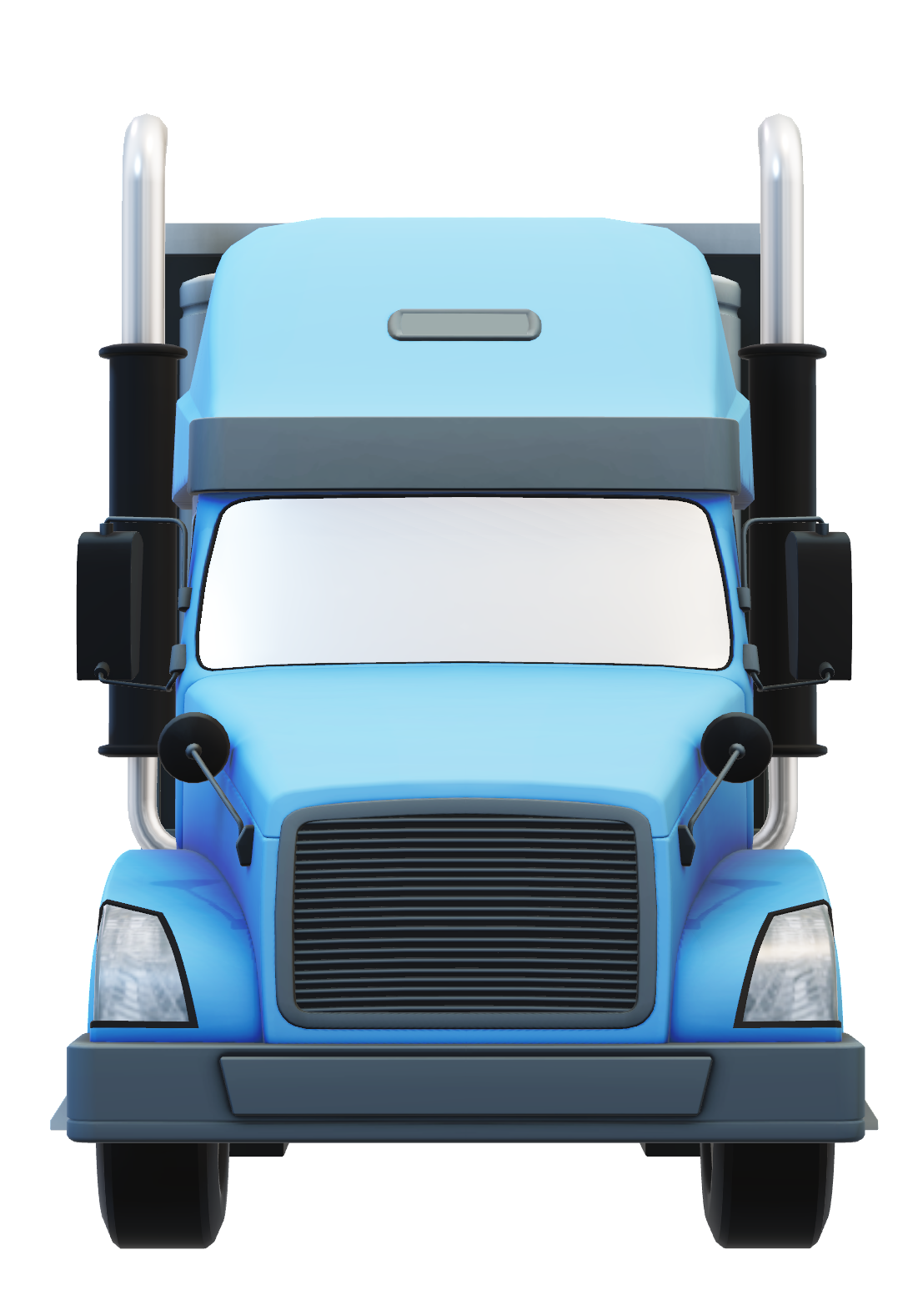
Conclusion
To reduce risk in areas like Santa Rosa, Willits, and Apple Valley, implement targeted safety measures addressing prevalent high-risk events, and enhance training for drivers using Ford, Caterpillar, Peterbilt, and Volvo trucks.
Implement route optimization and driver training programs to reduce idling, improve fuel efficiency.
Notes:
A19 –
Did not show up in any of our observations
Because this driver did not violate any observed traffic rule. And hence there was no Risk Factor assigned to them.
We’d like to urge all our drivers to be like A19.

Slide 9

ThanK you
Sushya Sri Kalyan Teja
Krishna Apurva
Siddhesh
Sai Lakshmi Harini
Saketh Kumar
Raunit
Harshitha
Notes:
Sushya Sri Kalyan Teja
Krishna Apurva (Conclusion)
Siddhesh
Sai Lakshmi Harini (Intro)
Saketh Kumar (Viz)
Raunit (Viz slide 5)
Harshitha (Challenges)

